Slide 1
Big data analytics project Amazon Customer Reviews Dataset
Brittany Bishop, Anuj Patel, and Archit Manuja

Slide 2
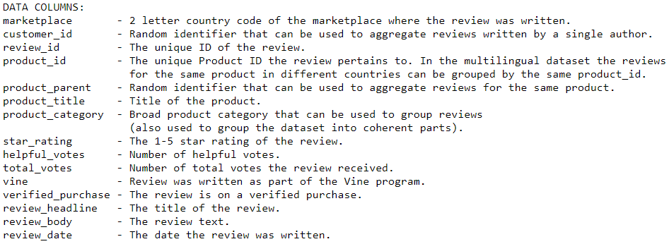
Dataset Variables

Slide 3
New Variables created
Review polarity - using textblob
headline_polarity
body_polarity
Review length - using len()
headline_length
body_length
helpful_ratio - (helpful_votes/total_votes)
helpful? - helpful_ratio > 0.75

Slide 4
Data exploration

Slide 5
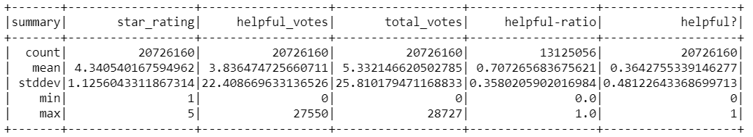
Data Exploration – “Books”

Slide 6
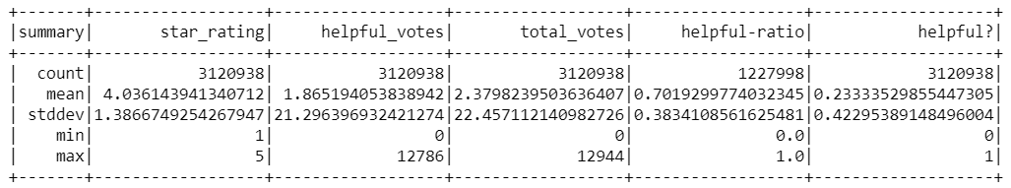
Data Exploration – “Electronics”

Slide 7
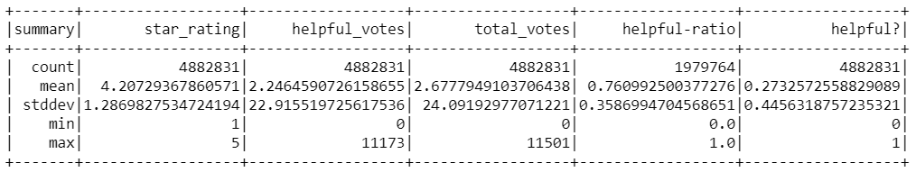
Data Exploration – “kITCHEN”

Slide 8
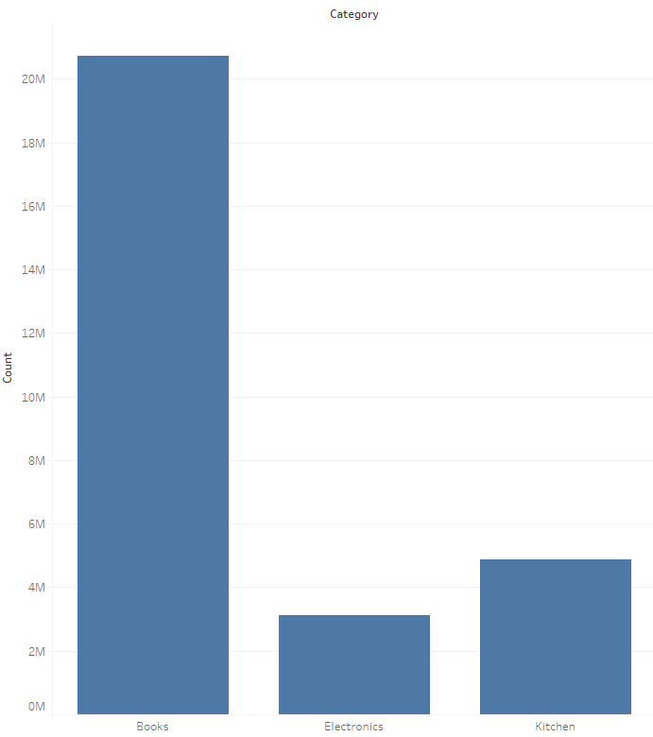
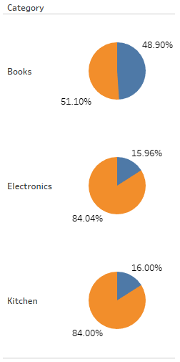

Data Exploration – GRAPHS

Slide 9
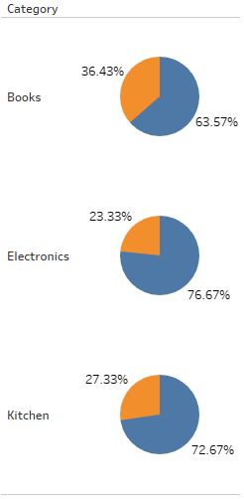

Data Exploration – GRAPHS

Slide 10
Logistic Model

Slide 11
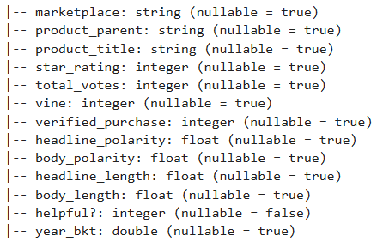
Model Variables/SCHEMA

Slide 12
Model Comparison
CATEGORY | AUC | PRECISION | ACCURACY
Books | 0.51 | 0.42 | 0.65
Electronics | 0.90 | 0.86 | 0.94
Kitchen | 0.96 | 0.94 | 0.97

Slide 13
Questions?

